Slide 1

CAPSTONE PROJECT: Analytical CRM Development for a Bank
Harsh Vardhan Patel

Slide 2


Analytical CRM Insights for Reducing Customer Churn and Enhancing Satisfaction
PROBLEM STATEMENT
Objective:
As an Analytical CRM Specialist, your task is to extract meaningful insights from the bank's customer-related datasets to achieve the following goals:
Reduce customer churn
Improve service delivery
Enhance customer satisfaction

Slide 3

Key Challenges:
Customer Churn:
Identifying patterns and factors contributing to customer churn.
Segmenting customers based on their churn risk and developing targeted retention strategies.
Service Delivery:
Analyzing customer transactions and interactions to identify service gaps.
Enhancing service delivery by understanding customer preferences and behaviors.
Customer Satisfaction:
Utilizing demographic and transactional data to gauge customer satisfaction levels.
Implementing strategies to boost overall customer satisfaction and loyalty.
Scope:
Use provided datasets to generate insights that align with the bank's strategic goals.
Develop actionable recommendations to address the identified challenges.

Slide 4
Data Overview
The bank has provided several comprehensive datasets that encompass customer information, transaction details, and customer statuses.
Bank Churn Table: Details metrics like credit score, tenure, account balance, number of products, credit card ownership, active status, and churn status.
Customer Info Table: Provides demographic data such as customer ID, surname, age, gender, estimated salary, geography, and date of joining the bank.
Active and Exit Customer Tables: Categorize customers based on their active status (activecustomer) and reasons for exiting (exitcustomer).
Credit Card Table: Contains information on credit card categories held by customers.
Gender and Geography Tables: Offer detailed classifications of gender and geographic locations, aiding in demographic and geographic analysis.
These interconnected datasets form a robust foundation for analyzing customer behavior, identifying churn patterns, and enhancing service delivery to boost customer satisfaction.

Slide 5
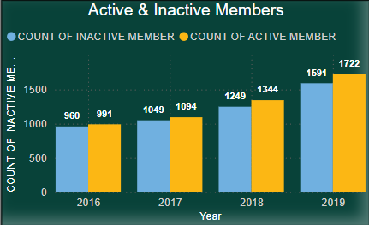
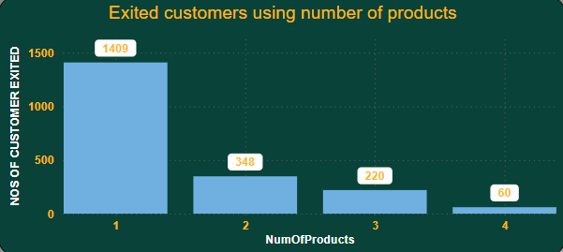
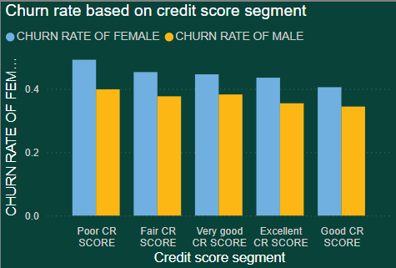
Analysis
ACTIVE & INACTIVE CUSTOMERS
PRODUCTS USED BY CHURNED CUSTOMER
COUNT OF CUSTOMERS EXITED/ CREDIT SCORE SEGMENT
Almost near to half of the customers are not active in the bank. it indicates a significant challenge in customer engagement and retention.
Strategies like rewards,offers,low interest rates,prompt customer support shall be provided to increase members activity.
Customers who use only one product may have limited engagement with the bank compared to those who use multiple products.
Implement retention strategies tailored to customers who use only one product, such as personalized outreach, loyalty rewards, or incentives or more products shall be promoted for use to encourage broader engagement.
Customers with fair credit scores may have limited access to credit or financing options, making it more difficult for them to manage their financial needs and obligations.
Implement retention strategies targeted specifically at customers with fair credit scores, such as personalized outreach, financial wellness programs, or credit-building initiatives.

Slide 6
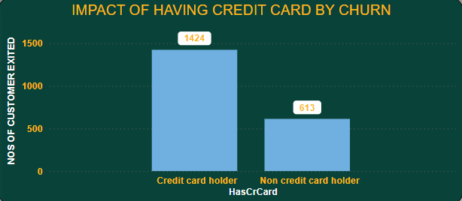
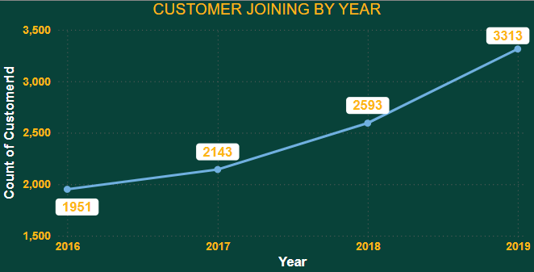
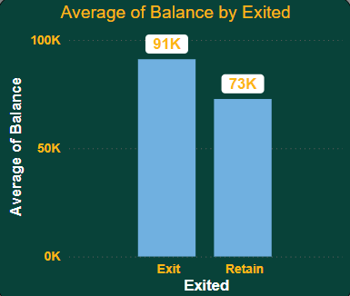
OBJECTIVE KEY FINDINGS
DISTRIBUTION OF CHURN BY CREDIT CARD
TREND OF CUSTOMER JOINING OVER YEARS
AVERAGE BANK BALANCE OF CUSTOMERS CHURNED
Churn among credit cardholders may signal dissatisfaction with the features, benefits, or terms of the credit card product itself or inability to manage credit card.
By credit card utilization patterns and spending behaviors of churned customers to identify any trends or insights strategies shall be implemented.
It suggests positive growth and expansion in the customer base.
However it is also necessary to manage the churn & retention rate for increasing the numbers of customer base.
Effective marketing strategies and campaigns may contribute to attracting more new customers.
Decision to leave the bank despite having a higher balance could indicate dissatisfaction with other aspects of the banking relationship, such as service quality, product offerings, or customer experience.
Implementing targeted retention efforts, such as relationship pricing, premium services, or VIP treatment for high-balance customers, can help incentivize them to stay with the bank.

Slide 7
Customer Behavior: Long-term customers (tenure > 5 years) have a higher average balance of $75,000 compared to new customers (tenure < 5 years) with $45,000, indicating greater loyalty.
Product Affinity: 7,055 active customers hold a credit card, while 2,945 do not, suggesting that credit card holders are more engaged with the bank.
Geographic Trends: France has the highest number of active customers (5,014), with Germany and Spain having approximately 2,500 each, indicating the need for regional marketing strategies.
Risk Management: Customers in Germany have an average balance of $100,000, exceeding their average salary of $75,000, highlighting a higher financial risk.
Customer Tenure Value: Older customers (50+) have higher lifetime values, suggesting that age and tenure are important factors in predicting customer value.
Marketing Effectiveness: The retention rate is 80%, with 10,000 retained customers versus 2,500 who exited, indicating that targeted offers could further improve retention.
Subjective Key Findings

Slide 8
Exit Reasons: Exited customers have an average balance of $30,000 and a tenure of 3 years, compared to active customers with a $60,000 balance and a 6-year tenure. Predicting Churn: Factors like 'Tenure', 'NumOfProducts', 'IsActiveMember', and 'EstimatedSalary' are crucial in predicting churn, with shorter tenures and fewer products increasing the likelihood of exit. Customer Segmentation: Age 18-30: Average balance $73,198.76 Age 31-40: Average balance $75,583.36 Age 41-50: Average balance $79,122.19 Age 51+: Average balance $79,951.38 Churn Risk: Conditional formatting in Power BI highlights that customers with balances below $20,000 and low credit scores are at a higher risk of churn.

Slide 9
Loyalty and Financial Stability: Long-term customers (tenure > 5 years) have a higher average balance of $75,000 compared to new customers (tenure < 5 years) with $45,000, reflecting greater loyalty and financial stability.
Credit Card Engagement: Customers holding a credit card (7,055) are more active compared to those without (2,945), indicating that credit card ownership is linked to higher engagement.
Regional Marketing Opportunities: France leads with 5,014 active customers, while Germany and Spain each have around 2,500. This suggests the need for targeted marketing strategies tailored to these regions.
Financial Risk in Germany: Customers in Germany have an average balance of $100,000, which is higher than their average salary of $75,000, highlighting a significant financial risk.
Retention and Churn: The bank has an 80% retention rate, with 10,000 retained versus 2,500 who exited. Increasing targeted offers could further enhance customer retention.
Insights

Slide 10
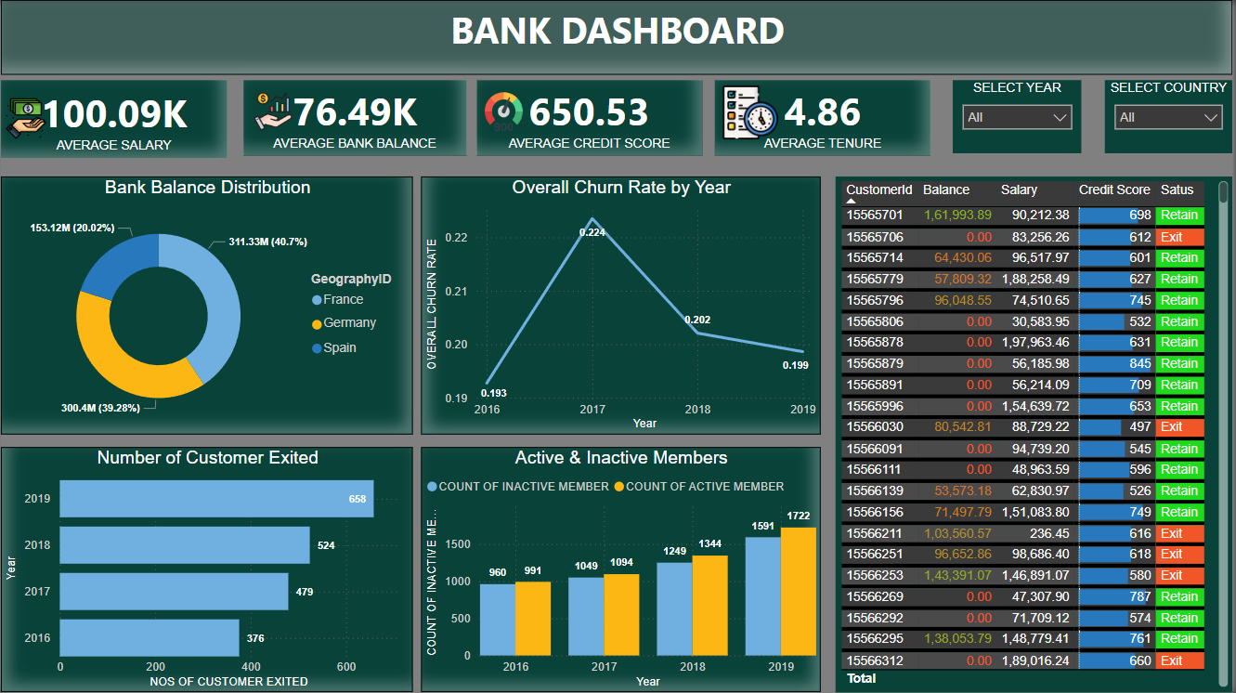

Slide 11
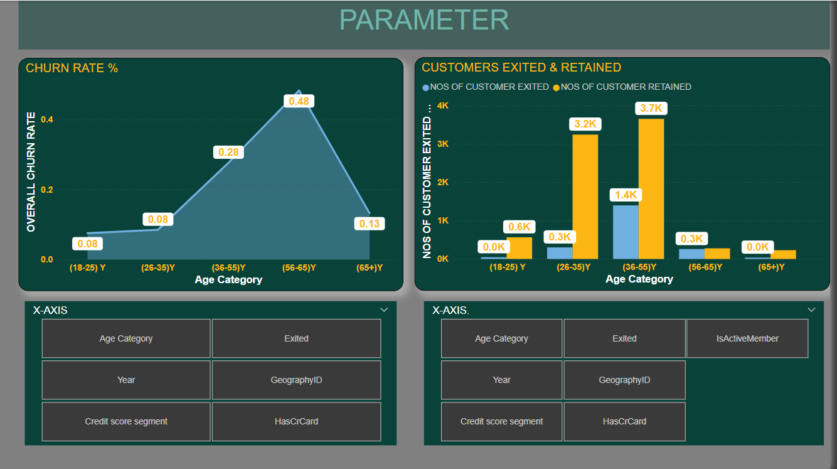

Slide 12
CONCLUSION
Long-term customers (over five years) show higher financial stability with an average balance of $75,000, compared to $45,000 for newer customers, highlighting the value of fostering long-term relationships to boost customer loyalty.
Credit card holders demonstrate significantly higher engagement, presenting a strong opportunity for cross-selling additional products.
France leads in the number of active customers, while Germany and Spain have similar figures, suggesting that targeted marketing strategies could improve customer acquisition and retention in these regions.
Customers in Germany exhibit a high average balance compared to their average salary, indicating a higher financial risk that necessitates tailored risk management strategies.
With an 80% retention rate, the bank can further reduce churn by offering more targeted promotions and offers.
Predictive factors such as tenure, number of products, and estimated salary are crucial for anticipating customer churn, enabling more effective retention strategies.
Implementing these insights can enhance customer engagement, manage risks, and drive overall business success.

Slide 13


